Slide 1

TravelMeds
With TravelMeds we aim to find the most similar medical product in a foreign country to a product that you already know from your home.
01

Slide 2





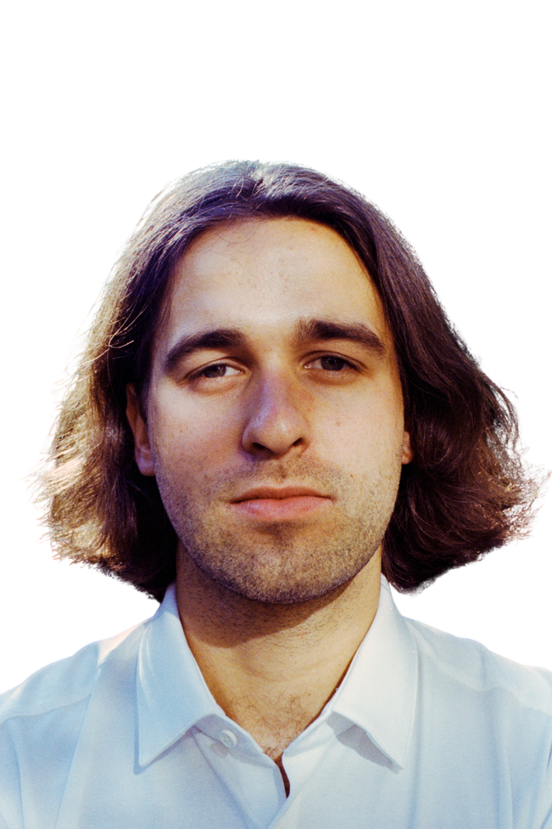

This is us
Valentin
Minh Anh
Clemens
Alex
Moritz
Lilit
02

Slide 3

Purpose
Demonstration of a web application that maps medicine used in different countries based on their main ingredients to get the most similar alternatives for users abroad.
03

Slide 4





Problem
How do I find out what
drug I need to ask for?
Paracetamol
Does the drug even
exist in this country?
Acetaminophen
C8H9NO2
Does the equivalent drug have the same dosage?
04

Slide 5




Market
ABDATA
IQVIA
05

Slide 6

Online Pharmacy Market in Europe
3.34 bn € revenue (2022)
13.23 % expected annual growth
16.96 € Average revenue per user
5.50 bn € revenue projected for 2026
06

Slide 7





User Validation
DOCTOR
PHARMACIST
Expert User
Expert User
"More product details to be added."
"It would be nice if we could partner up with TravelMeds."
MIDDLE AGE TRAVELER, IMMIGRANT
MILLENIAL TRAVELER, EXCHANGE/OVERSEAS STUDENT
Casual User
"TravelMeds is exactly what I need when traveling."
Casual User
"This innovation is fantastic, I would definitely use it for my semester abroad."
07

Slide 8




Technical Solution
Algorithm
TravelMeds
DrugBank
User Input
Medication Recommendation
HMA
Database
Other Sources
08

Slide 9
Algorithm
Country | Product Name | Drug Route | Drug Name | Drug Strength | Drug Unit
AUSTRIA | CAPOZIDE 25 | ORAL | CAPTOPRIL | 25.0 | mg
AUSTRIA | CAPOZIDE 25 | ORAL | HYDROCHLOROTHIAZIDE | 25.0 | mg
Country | Product Name | Drug Route | Drug Name | Drug Strength | Drug Unit
CANADA | HYDROCHLOROTHIAZIDE TAB 25MG | ORAL | HYDROCHLOROTHIAZIDE | 25.0 | mg
09

Slide 10

What users may have seen so far
10

Slide 11
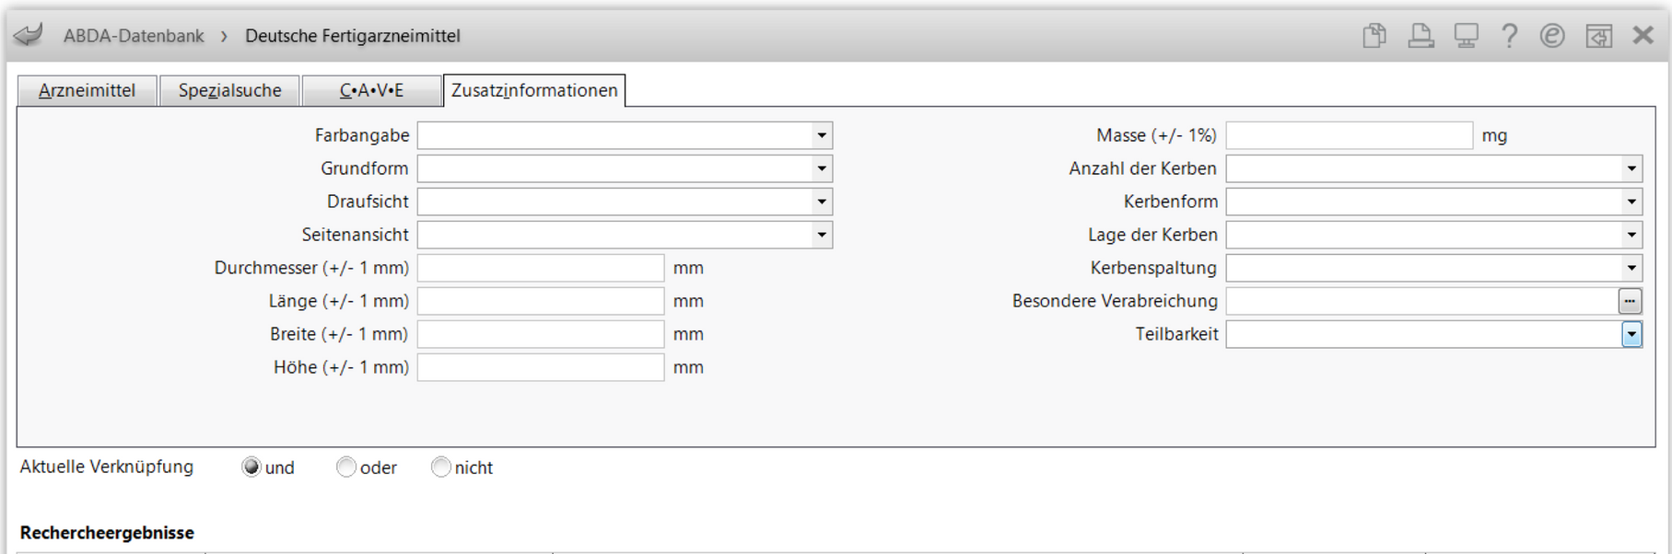
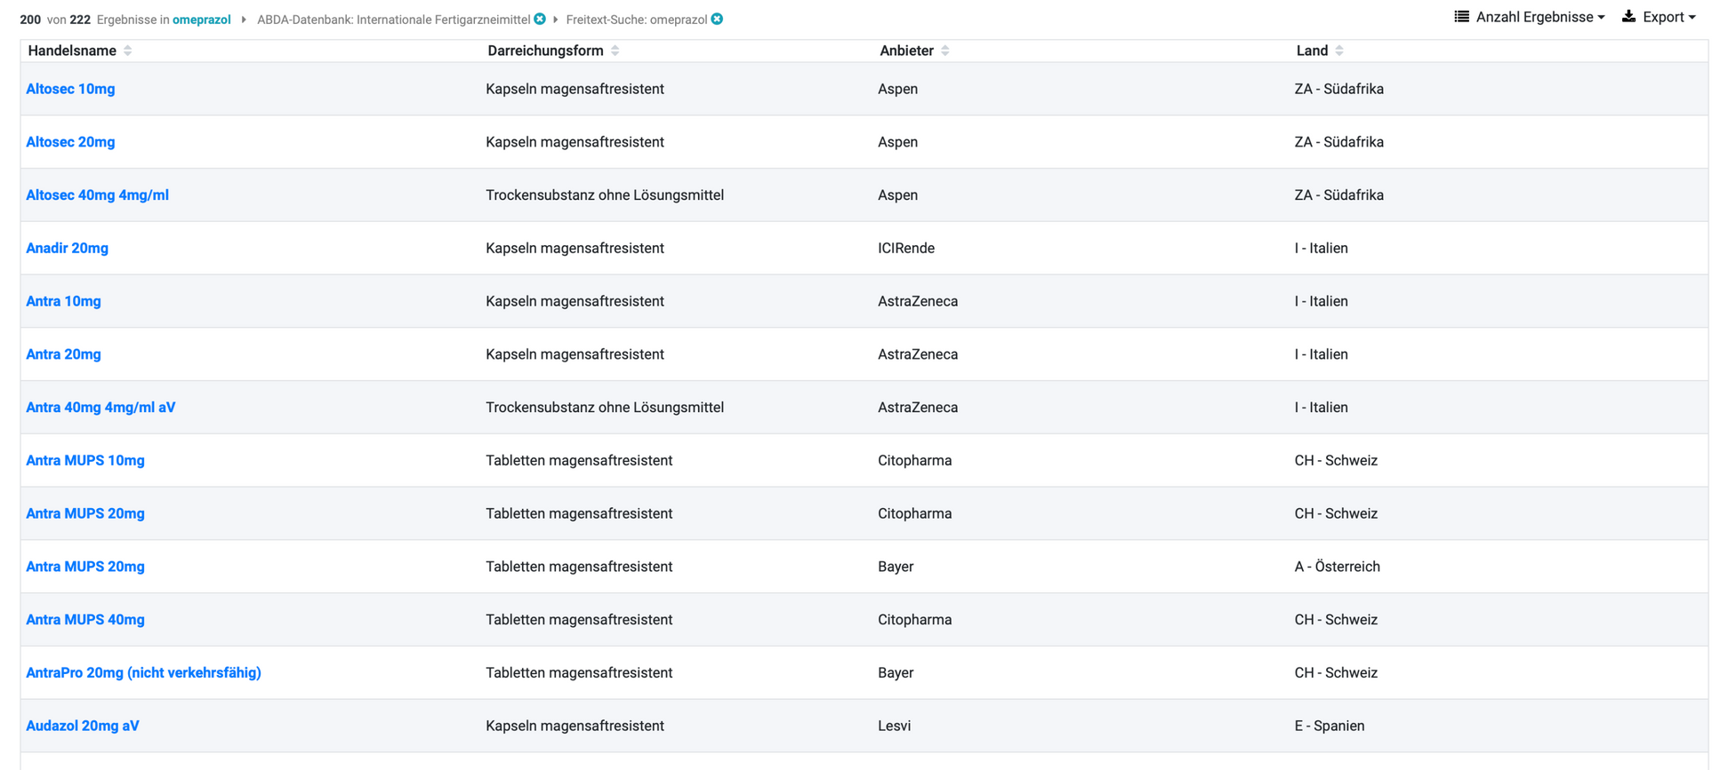
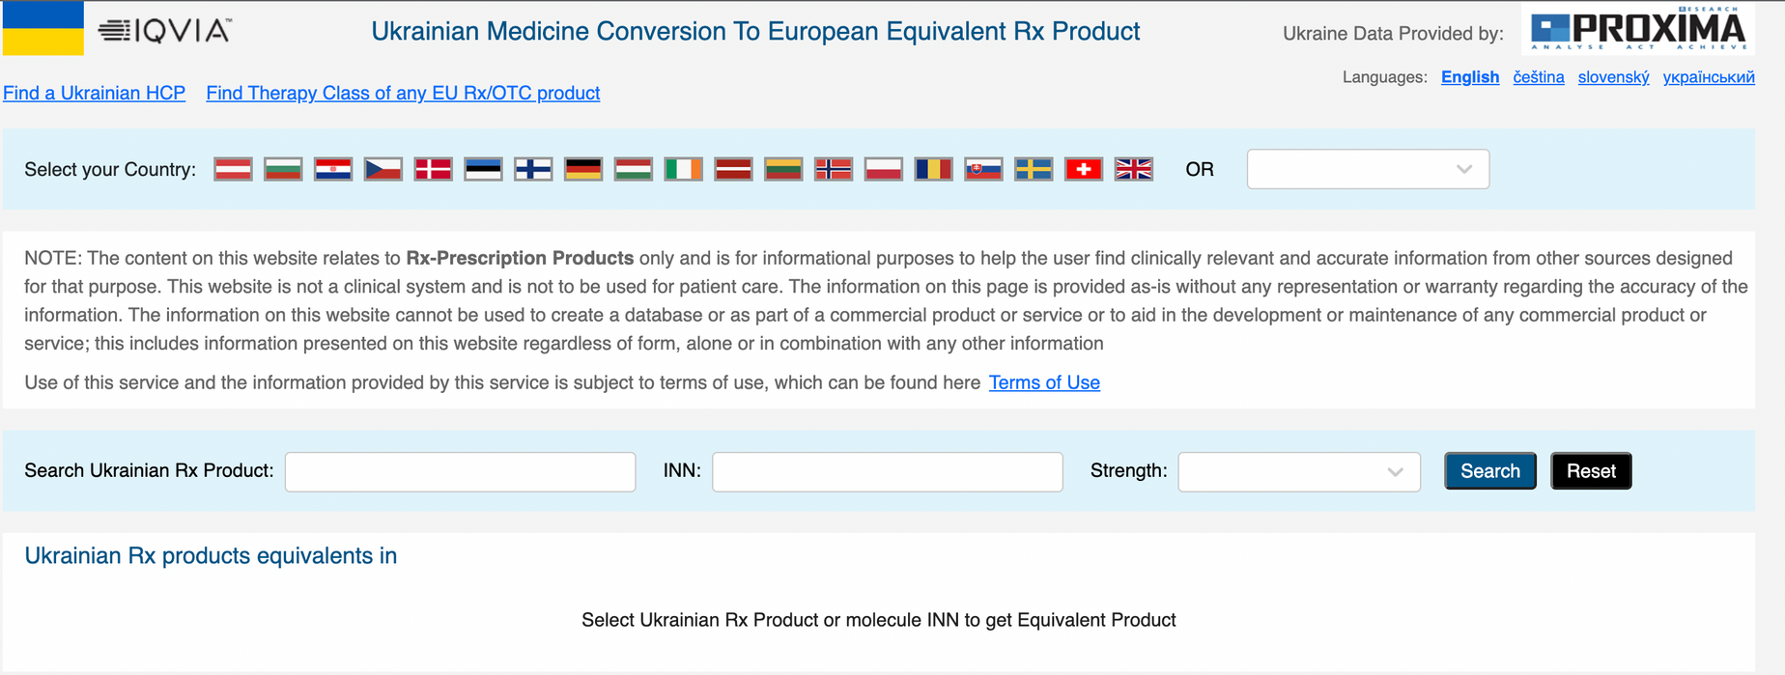
11

Slide 12

How about we show you the technical prototype live?
12

Slide 13
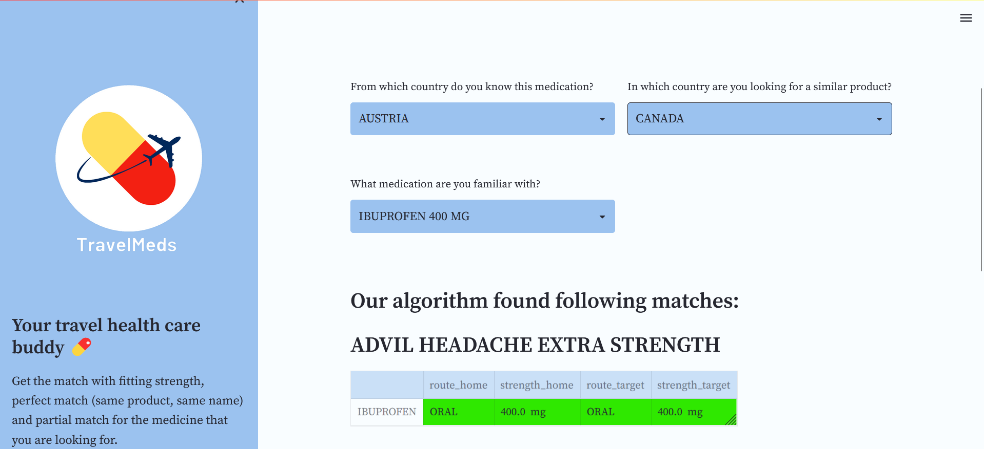
13

Slide 14
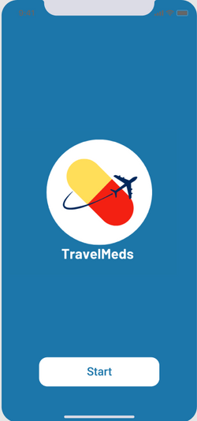
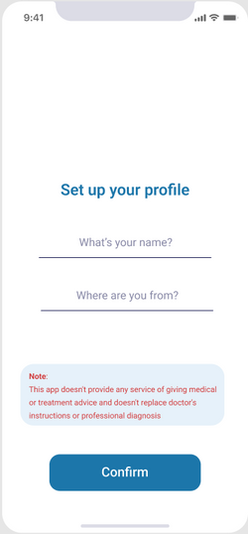
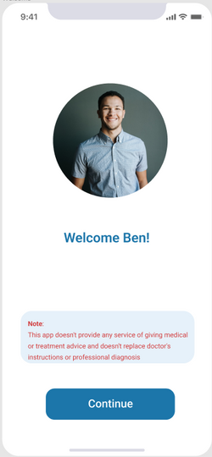
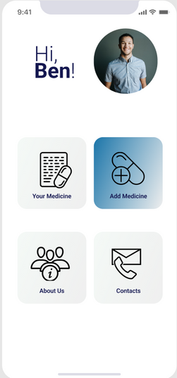
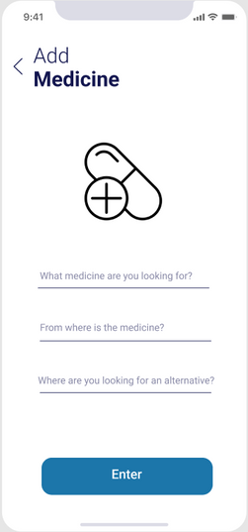
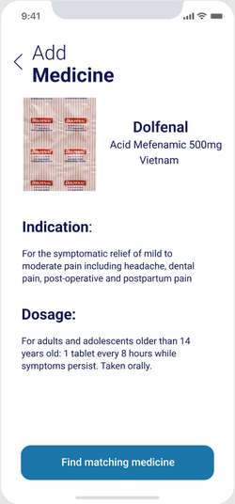
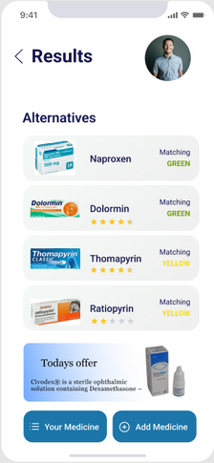
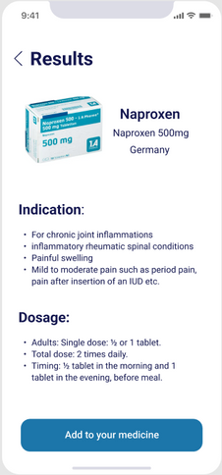
Figma
Prototype
14

Slide 15

Thank you!
Join us on our path!
Do you have any questions?
15

Slide 16
Online Pharmacy Market in USA
3.43 bn $ revenue (2022)
6.16 % expected annual growth
32.18 $ Average revenue per user
4.36 bn $ revenue projected for 2026
16

Slide 17





Additional
Product Features
Improve algorithm: strength, producer
Suggest nearby pharmacy location
Medicine name in
both native and
foreign language
Scan medicine barcode to get information
Inform user if prescription is needed
Find medicine based on synonyms
17

Slide 18

MARKETING & LEGAL TEAM
do further research for product development, in charge of licensing sources
DATA ENGINEER & DATA SCIENTIST
retrieving, preprocessing data and improving the algorithm
WEB DEVELOPER & UX DESIGNER
enhance the usability and user-friendliness of our website
18

Slide 19

References
EU Market: https://www.statista.com/outlook/dmo/digital-health/ehealth/online-pharmacy/europe?currency=EUR
NA Market: https://www.statista.com/outlook/dmo/digital-health/ehealth/online-pharmacy/united-states?currency=USD
Figma: https://www.figma.com/file/TBmxeTufn55tKRs85rW0Vu/TravelMeds-Prototype?node-id=0%3A1
19

Slide 20




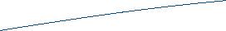




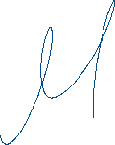

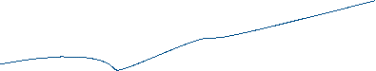


Plagiarism Disclaimer
We hereby declare that this presentation solely is our own and autonomous work. All sources and aids used have been indicated as such. All texts either quoted directly or paraphrased have been clearly indicated by in-text citations. Full bibliographic details are given in the reference list (see “References”). All internet sources used are also listed in the references list, showing URL and access date. This work has not been submitted and will not be submitted to any other examination authority.

